Slide 1

SPORTS EVENT MANAGEMENT SYSTYEM

Slide 2
OVERVIEW
The Sports Event Management System for SRM AP University is a web-based platform that simplifies event registrations, tracks achievements, and facilitates communication among students, administrators, and faculty. It features a centralized dashboard for efficient event management with real-time updates and a user-friendly interface. The system includes a dynamic registration portal for both individual and group events, incorporating validation to prevent duplicate entries. A dedicated section showcases participant achievements, while administrators manage event details and faculty oversee platform maintenance and security. With a responsive design and secure communication protocols, the system enhances efficiency in sports event management and fosters seamless collaboration among university stakeholders.

Slide 3
Purpose & Objectives
Centralized platform for managing sports events
Simplifies event registration & administration
Enhances collaboration among students, faculty & administrators
Provides secure & transparent data management
Technology Stack
Frontend: HTML, CSS, JavaScript
Backend: PHP, MySQL

Slide 4
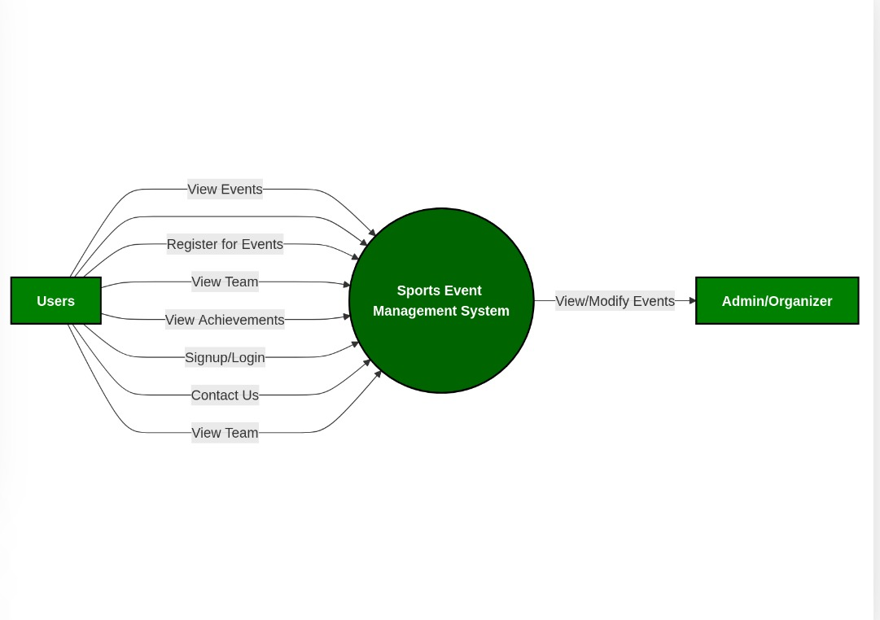
A Functional Data Flow Diagram (DFD) visually represents how data moves through a system, highlighting processes, inputs, outputs, and data storage without focusing on implementation details
LEVEL - O
Level 0 is the highest-level Data Flow Diagram (DFD), which provides an overview of the entire system. It shows the major processes, data flows, and data stores in the system,

Slide 5
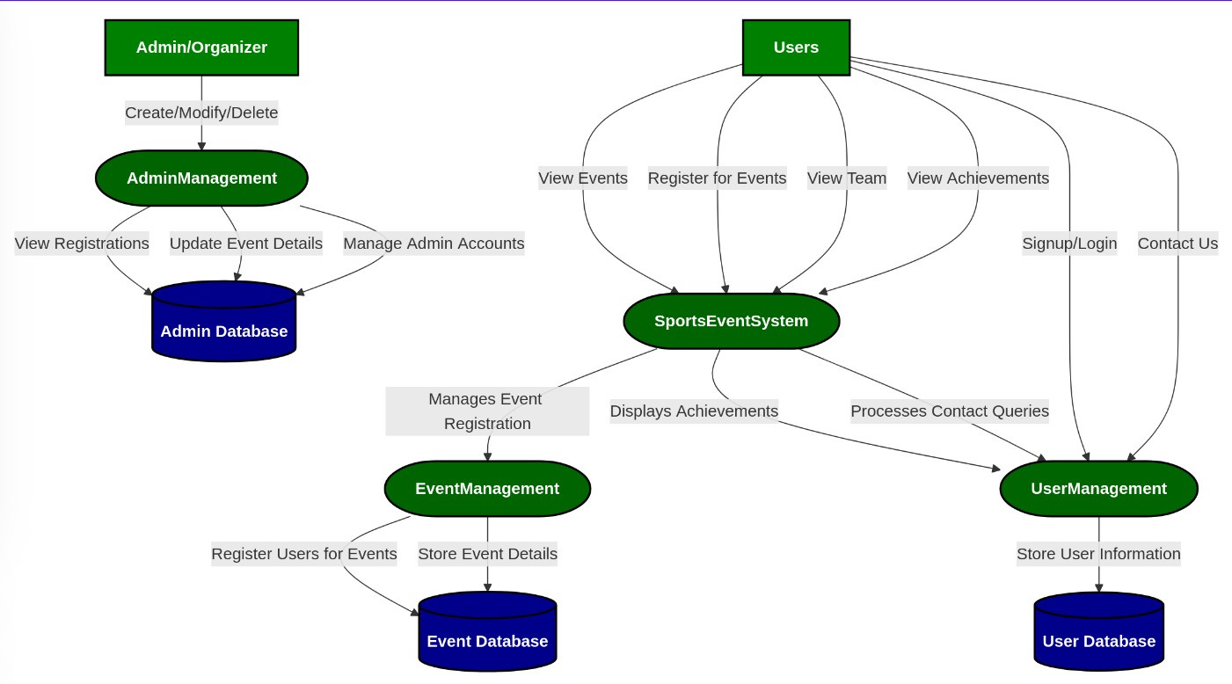
LEVEL - I
This is the Level 1 Data Flow Diagram (DFD) for our Sports Event Management System. It visually represents how data flows between different entities, processes, and databases.

Slide 6
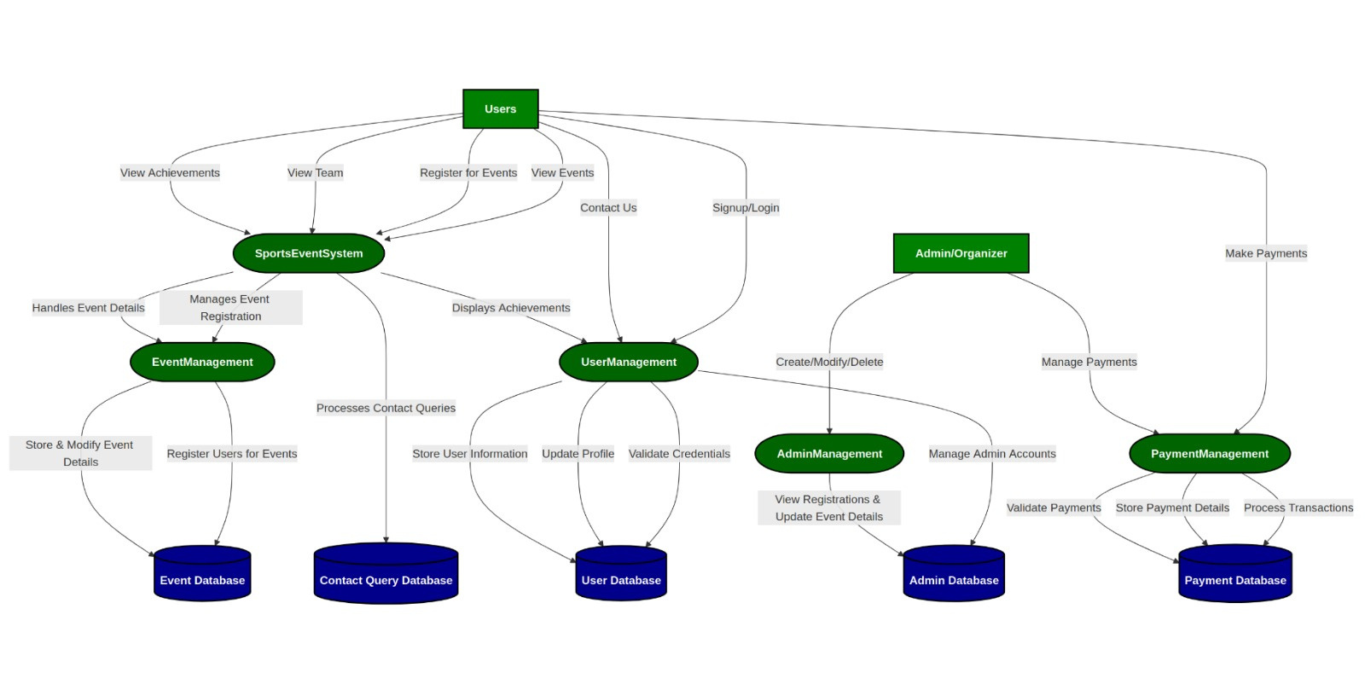
LEVEL - II
This is a Level-2 Data Flow Diagram (DFD) for a Sports Event Management System. It details the interaction between users, admins, processes, and databases.

Slide 7
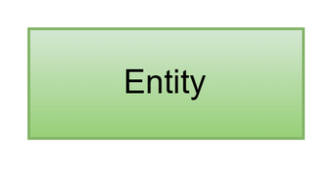
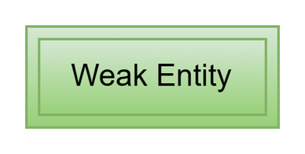
ER-DIAGRAM
An ER (Entity-Relationship) diagram is a visual representation of the structure of a database. It shows the entities (objects or concepts) within a system and the relationships between them. It is used in database design to organize data efficiently before implementation.
SYMBOLS IN ER-DIAGRAM
Entity
An entity is an object in the real world that has a distinct existence. In ER Diagram, the entity is represented as a rectangle. Each entity will have its name inside the rectangle, and the relationships between them will be defined using diamonds connecting the entities.
A strong entity has a primary key and exists independently in a database.
Weak Entity
A Weak Entity is an entity that depends on a Strong Entity for its identification and does not have a primary key of its own. It is represented by a double rectangle in an ER Diagram and is linked to the strong entity using a double diamond relationship.

Slide 8
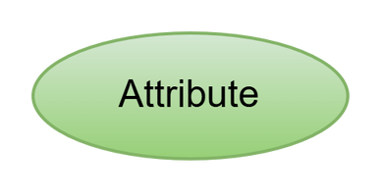
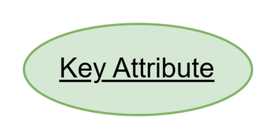
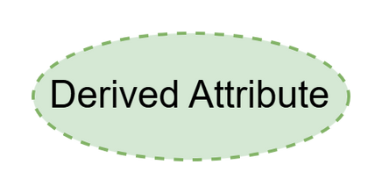
Attribute
An attribute defines the properties of an entity. It is represented by an oval in an ER diagram and holds specific data values related to the entity. (Simple Attribute)
Key Attribute
A key attribute is an attribute that uniquely identifies (primary key) an entity in an ER diagram. It is represented by an oval with an underline.
Derived Attribute
Derived attributes can be derived from the other attribute. These attributes are not present in the database physically but they can be derived from the other attributes easily.

Slide 9
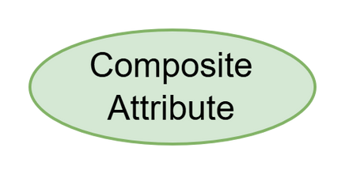
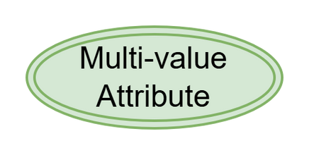
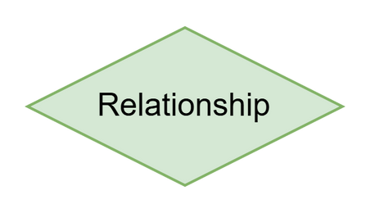
Composite Attribute
A composite key is a combination of multiple columns in a database table that uniquely identifies each record.
Multi-valued Attribue
A multi-valued attribute is an attribute that can have more than one value associated with an entity's key.
Relationship
A relationship represents how two or more entities are associated with each other. It is depicted using a diamond symbol and connects entity sets with meaningful associations. Relationships can have different cardinalities, such as one-to-one (1:1), one-to-many (1:M), and many-to-many (M:N). (one entity can be assciated with another.

Slide 10
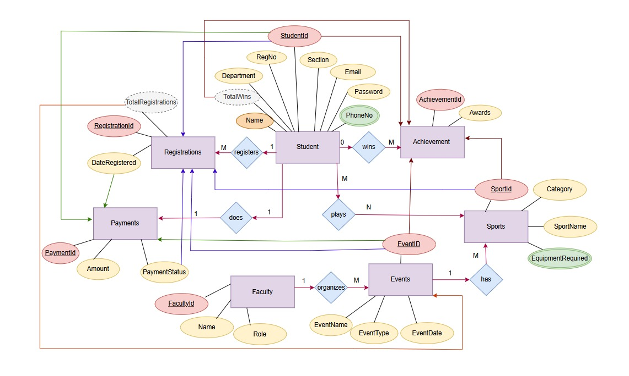
SPORTS EVENT MANAGEMENT SYSTEM

Slide 11
SPORTS EVENT ER-DIAGRAM
Entities (Rectangles):
Student: Stores student-related information.
Registrations: Keeps track of student registrations.
Achievement: Records accomplishments by students in various sports.
Payments: Handles transaction details.
Faculty: Manages faculty members and their roles.
Events: Store event-related details.
Sports: Manages sports activities and their requirements.
Attributes (Ovals):
Student: StudentId (key), Name (comp), RegNo, Department, Section, Email, Password (simple), PhoneNo (multi), TotalWins (derived)
Registrations: RegistrationId (key), StudentID, EventID, SportID, PaymentStatus, DateRegistered (simple), TotalRegistrations (derived)
Achievement: AchievementId (key), StudentID, EventID, SportID, Awards (simple), TotalWins (derived)
Payments: PaymentId (key), StudentID, EventID, Amount, DateRegistered, PaymentStatus (simple)
Faculty: FacultyId (key), Name, Role (simple)
Events: EventId (key), EventName, EventType, EventDate (simple), TotalRegistrations (derived)
Sports: SportId (key), SportName, Category (simple), EquipmentRequired (multi)

Slide 12
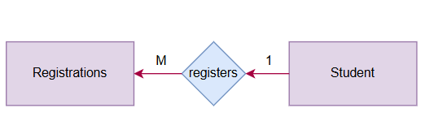
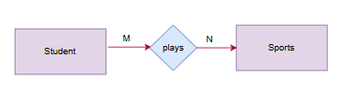




SPORTS EVENT ER-DIAGRAM
Relationships (Diamonds) and Cardinalities:
Registers - (1:M) A student can register for multiple events
Plays - (M:N) Many students can play many sports
Wins - (0:M) A student may or may not have achievements
Does - (1:1) A student makes payment for registration.
Organizes - (1:M) A faculty member organizes multiple events
Has - (1:M) An event can include multiple sports

Slide 13
THANK YOU
V. REVANTH - AP22110010109
K. BANDHAVI - AP22110010079
N. SWATHI - AP22110010084
K. VAISHNAVI - AP22110010126

